Slide 1





Employer Relationships:
Is it time to re-think our approach?
David Hoff
Program Director
Institute for Community Inclusion
UMass, Boston
Board President
National APSE

Slide 2



David Hoff
617-287-4308
david.hoff@umb.edu
www.communityinclusion.org
www.apse.org

Slide 3

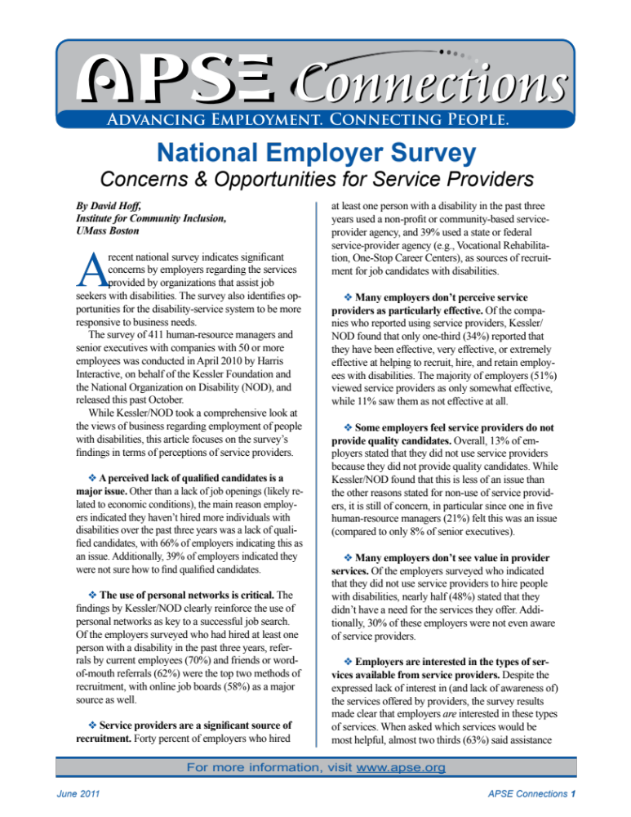
Handout
APSE Connections:
National Employer Survey
I will be happy to send copies of the PowerPoint

Slide 4


A
Job Development Story
The Employer

Slide 5


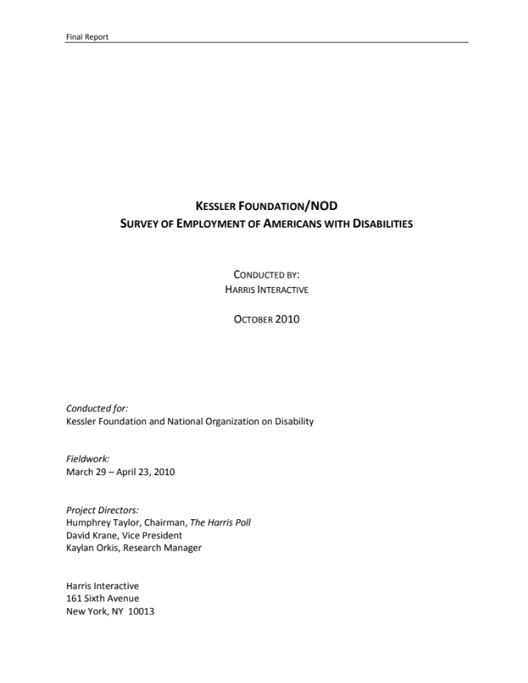



Slide 6


Survey of 411 human resource managers and senior executives with 50 or more employees
Broad based survey on views of
employees with disabilities
Part of survey focused on views of service providers
  Non-profit community provider, federal or state agency (public vocational rehabilitation, One-Stop, etc.)
Available at:
www.2010disabilitysurveys.org/octsurvey/index.html

Slide 7
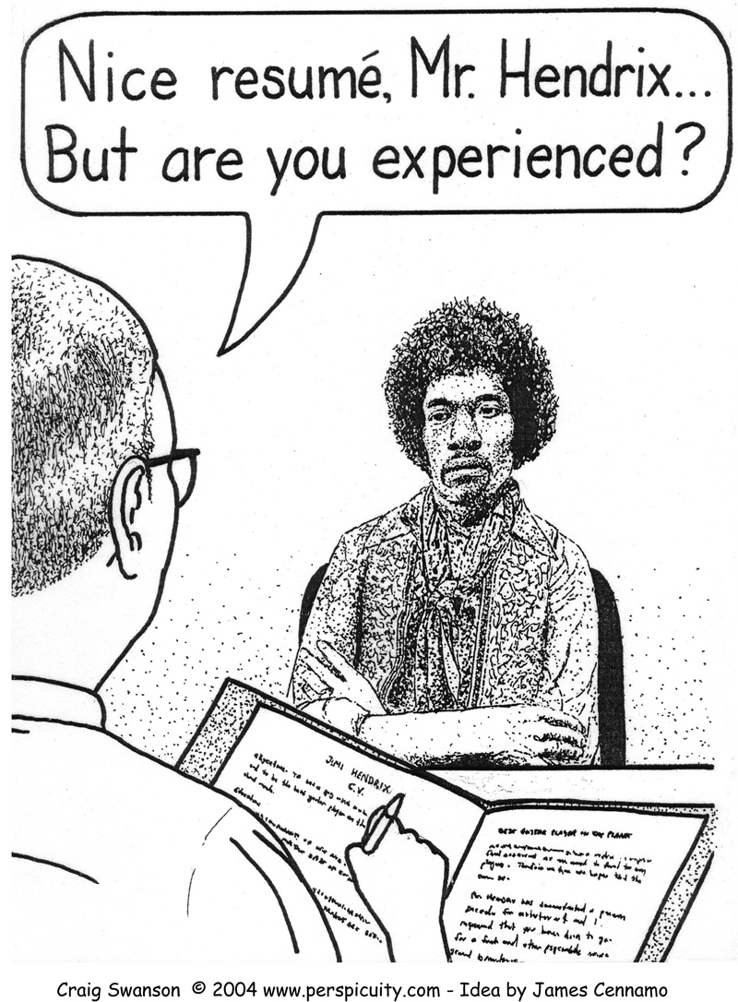

Slide 8


What Employers are Saying
They value hiring employees with disabilities – but they have trouble finding qualified candidates with disabilities
Many don’t know where to recruit people with disabilities
Many don’t value or are even aware of service providers
Those that have worked with service providers have “mixed” feelings about the experience

Slide 9

Business View of Service Providers
Kessler Foundation/National Organization on Disability Survey - 2010
QUESTION: If you have used a service provider, how effective have they been in recruiting, hiring, and retaining people with disabilities?
Response Choices:
1. Extremely Effective
4%
2. Very Effective
14%
3. Effective
16%
4. Somewhat Effective
51%
5. Not Effective
11%
6. Unsure
4%

Slide 10


Employers Perceived a Lack of Qualified Candidates
With Disabilities
66% of employers indicated this as an issue
39% of employers indicated they were unsure how to find qualified candidates
Source: Kessler Foundation/NOD Disability Survey - 2010

Slide 11
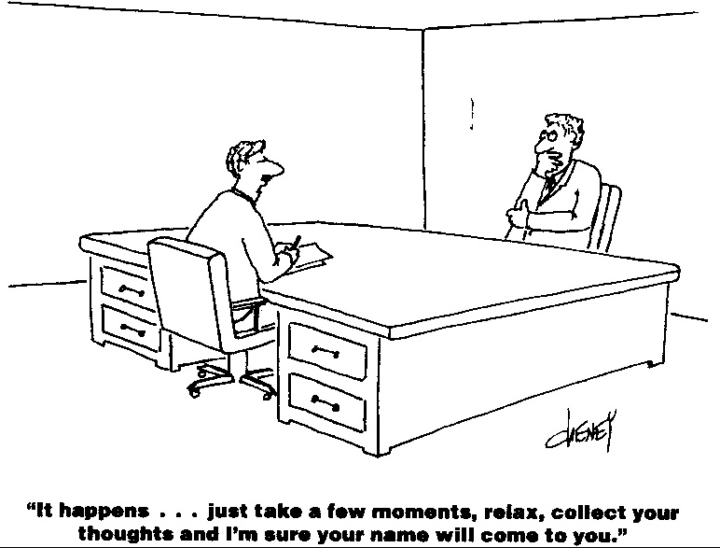

Slide 12


13% of employers felt that service providers did not provide qualified candidates
1 out of 5 human resource managers surveyed felt this was an issue
Quality of Job Applicants
Source: Kessler Foundation/NOD Disability Survey - 2010

Slide 13


Many Employers Don’t See Value in Service Providers
Employers that did not use service providers to hire people with disabilities: nearly half (48%) stated that they didn’t have a need for the services they offer
30% of employers were not even aware of service providers
Source: Kessler Foundation/NOD Disability Survey - 2010

Slide 14


What Employers Say They Want Help With
Finding qualified candidates
Expertise and assistance on job accommodations and assistive technology
Post-placement support, including job coaching
Matching job descriptions with skills of candidates

Slide 15


Use of Personal Networks is Critical
Referrals by current employees or friends or word-of-mouth referrals were top two methods of recruitment
Online job boards were also major source of recruitment

Slide 16
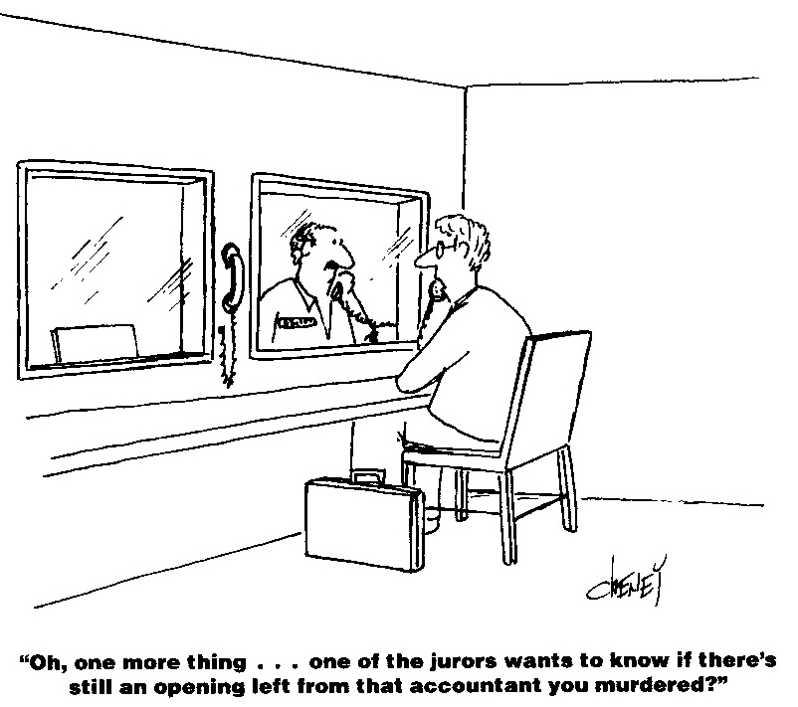

Slide 17



What Job Development Is Not
Filling out job applications
Searching for jobs on the internet

Slide 18


Key to Any Job Search:
Networking, Networking, Networking

Slide 19



“You can teach a turkey to climb a tree, but it’s easier to hire a squirrel.”
From: Lyle Spencer, David McCleelan, Signe Spencer - Competency Assessment Methods

Slide 20


Discussion:
Implications of survey results
What do we need to do differently?

Slide 21


“Given a choice between changing and proving that it is not necessary,
most people get busy with the proof.”
- John Kenneth Galbraith

Slide 22


“ A ship in harbor is safe ---
but that is not
what ships are built for. ”
John A. Shedd

Slide 23


“For far too long the shabby treatment of the many millions of the mentally disabled in custodial institutions and many millions more now in communities needing help
has been justified on grounds of
inadequate funds, further studies
and future promises.
We can procrastinate no more.”
- President John F. Kennedy
February 1963

Slide 24

Thanks for Attending!

